Slide 1
Support Process
Michelle McCausland

Slide 2
Topics
General overview
Life of a support ticket
Daily stand up and scrum
Support people
Some new processes
Notes:
General Overview – history of the support process, what it is etc.
Support people – various levels on the support hierarchy and their roles in the process
Life of a support ticket – the different stages a ticket goes through following the support process
Daily stand up and scrum – the different meetings check ins that we have on a daily basis
Some new processes that are being implemented since the new support process and future ideas

Slide 3

General Overview
This presentation covers the support process in terms of the life of a support ticket and how the support process works on a day to day basis.
The new support process was implemented in December 2015.
The support process is a constantly evolving process.
Everyone should have a hand-out of the support process on their desk!

Slide 4

Support People
Level 1 Support
  These are the only people on the support@errigal.com distro.
  They are responsible for creating tickets based on emails received from the customer.
  Works on a schedule – the person in the evening sends out support overview email.
Level 2 Support
  These are the people that work on support tickets.
  It is up to these people to always have support tickets up to date.
  Level 2 support are also responsible for Watchdog monitoring.
On Call Support
  This relates to people that are on-call at weekends or over holiday periods.
  People log into oncallsupport@errigal.com to monitor service impacting issues.
Support Team Leads
  Michelle – Support Lead/ Support Co-ordinator
  Cathal - Support Technical Lead

Slide 5
Life of a Support Ticket
A support board workflow is made up of sections/ columns/ swim lanes.
This shows you what status a ticket is currently in.
The main support workflows are made up of 6 columns:
  1. To do
  2. On Hold
  3. In Progress
  4. Response Received From Customer
  5. Awaiting Response From Customer
  6. Closed
It is up to each support person to ensure all assigned tickets are in the correct columns on a day to day basis.
To do
Ticket Created & Assigned
In progress
Work on ticket
Closed
Work Done

Slide 6
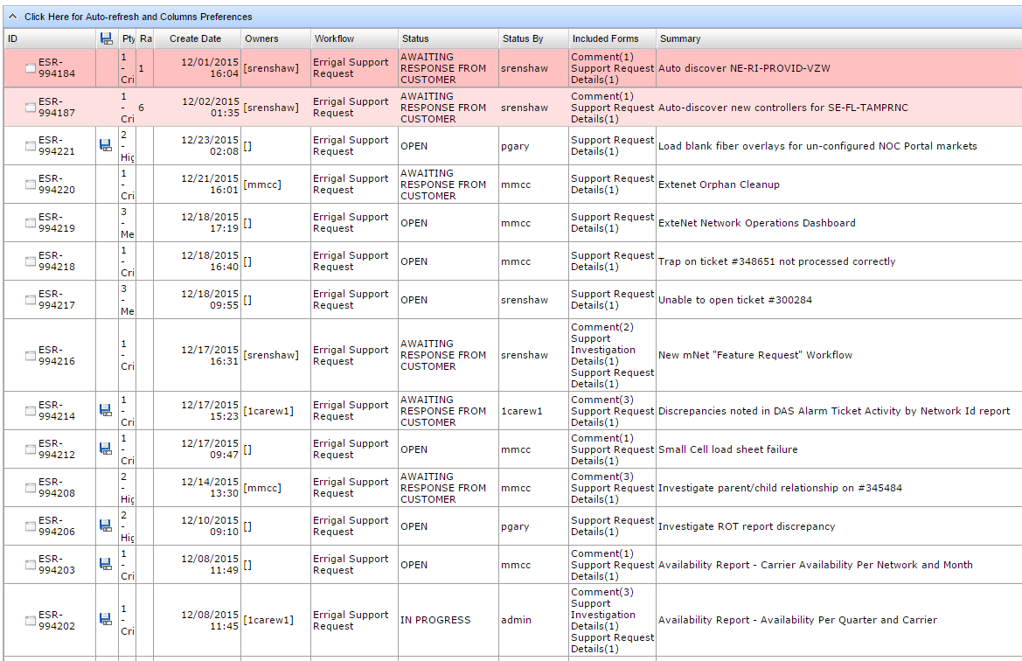
Notes:
Swim lanes
Priorities
Assignments
Filters

Slide 7
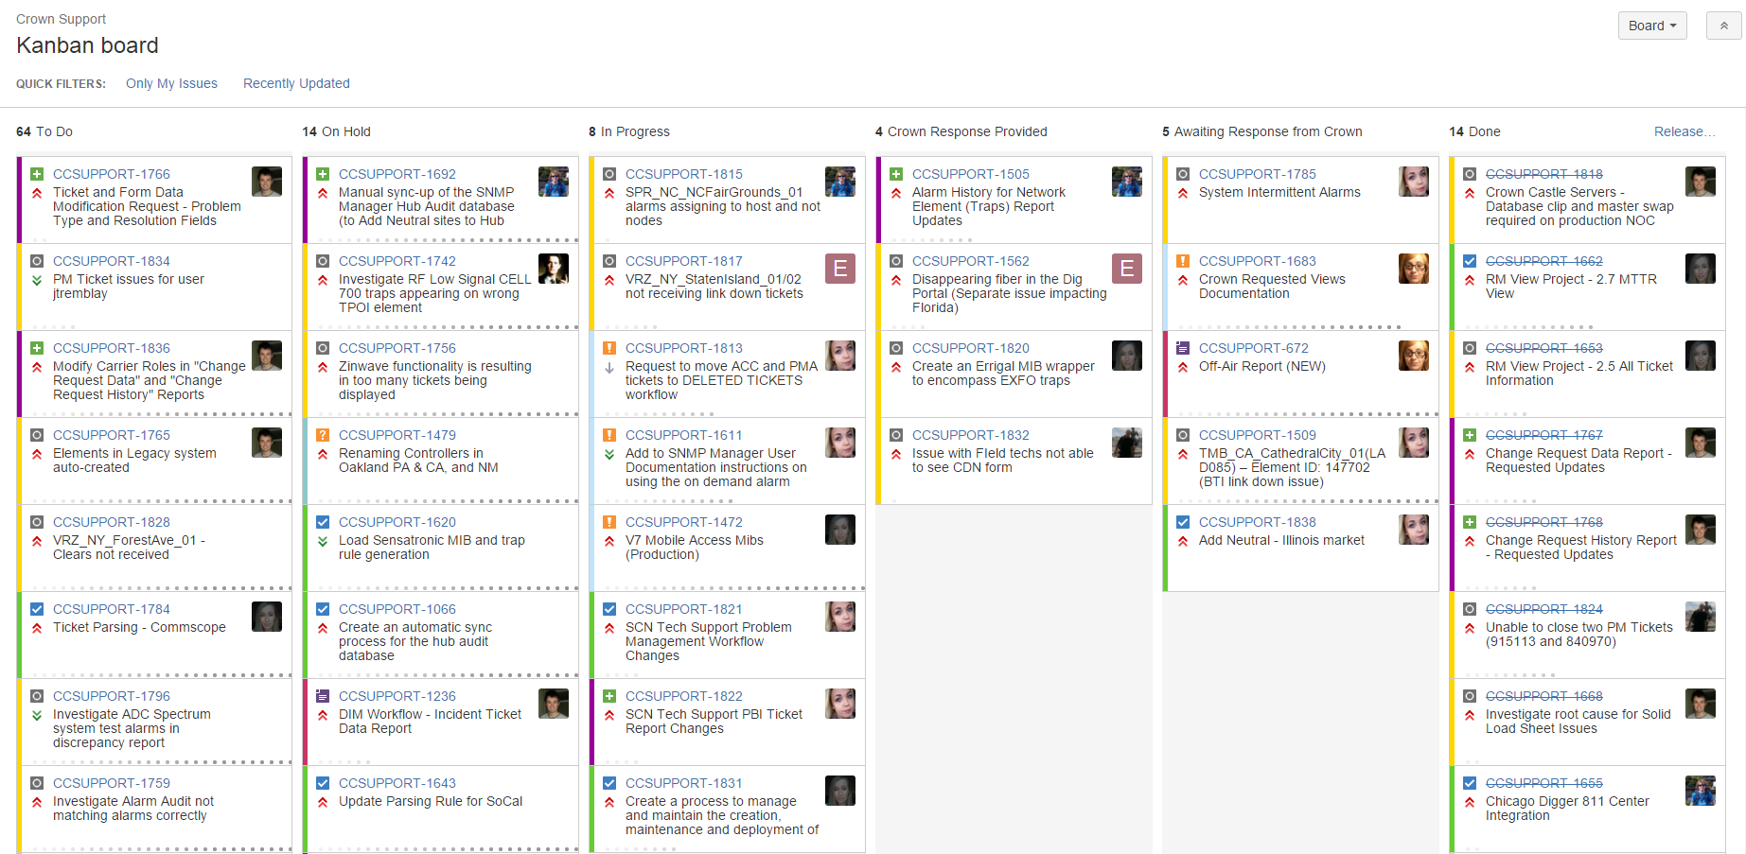
Notes:
Swim lanes
Priorities
Assignments
Filters

Slide 8
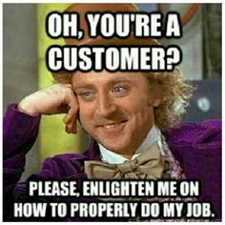
Ticket Creation
A support ticket usually starts life as an email request from the customer.
The Level 1 support person will create the ticket accordingly.
Tickets are created for all emails received to support.
It is placed in the backlog into To do and prioritized appropriately.

Slide 9

Assigning Tickets
The top 10 tickets in each customer’s backlog are assigned to people on Level 2 support by the support coordinator.
This is done via a formal email from the support coordinator:
  Should contain a forwarded copy of original email thread.
  Will state that X has been assigned to this ticket.
This ticket is now this person’s responsibility to move through the support process.
Notes:
Once the ticket has been assigned you should ensure that you are assigned to the support ticket on either Jira or Scotty pro AND ensure a physical ticket is added to the Kanban board.

Slide 10
Working On A Ticket
When the person on Level 2 support begins work on the ticket it is moved to In Progress.
They will read the ticket requirements thoroughly, including any existing comments and begin working on the ticket.
Once the requirements of the ticket have been met e.g. a report has been deployed to QA for testing, an email must be sent to the customer detailing:
  The ticket number for reference
  What work has been completed
  What database, if relevant i.e. QA or production
Once the email has been sent it is VERY important that you update the support ticket with this correspondence AND ensure your harvest is up to date.
Now you can move the ticket to Awaiting Response From Customer.

Slide 11
Working On A Ticket - Ctd
If there has been no response from the customer after 7 days of the ticket being moved into awaiting response, a follow up email must be sent to the customer asking for an update.
If after a further 7 days there has been no response this is then escalated to the support coordinator who will action as appropriate.
If a ticket cannot have any work carried out until some criteria or information is found / implemented, the ticket is placed on hold until such time as work can resume.
When a customer has responded to a ticket they will place it in response received.
The support person assigned to this ticket is responsible for moving it out of this state:
  Either back to In Progress when work continues on the ticket
  Or back into awaiting response from customer following an email to the customer
  Or into closed
The ticket is in this column because the customer believes it is no longer their responsibility. As such, you must send an email to the customer explaining the work carried out in order to move this ticket back to awaiting response from customer.

Slide 12
Difficulties With A Ticket
The first port of call for any difficulties encountered with tickets is to consult the Evernote repository.
If this does not prove fruitful, be sure to make note of this as a potential addition to the repo.
The next step is to ask for assistance from someone you believe can help you.
If you cannot find the appropriate assistance escalate your difficulty to the support coordinator (Michelle) who will ask you:
  What is the problem you are facing?
  Have you consulted Evernote?
  Have you asked for assistance? – If so from whom?
If a resolution is still not achieved the ticket will be further escalated and possibly reassigned.

Slide 13

Moving from Support to Dev
In some cases a person working on a support ticket is drafted into a development sprint.
This does not mean the ticket should be abandoned.
It is up to the assignee of the ticket to either monitor the ticket’s progress or to inform the support coordinator that the ticket needs to be reassigned.

Slide 14
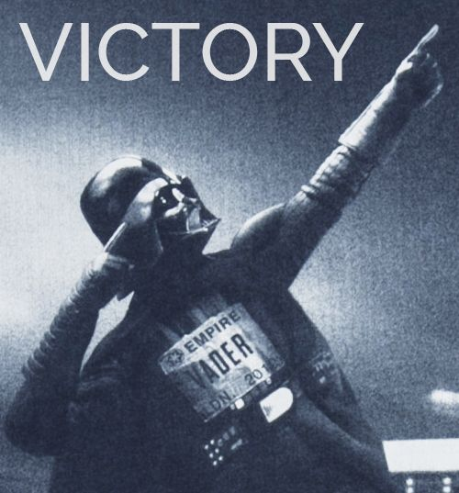
Closing Tickets
Once the work is completed on a ticket and we are given the go ahead from the customer, the ticket is closed.
A closing comment must be added to the ticket detailing the resolution reached and that the customer signed off on its closure.
The more tickets we close in any given week the happier our customers will be!

Slide 15
Daily Support Stand Up
This support stand up takes place every day at 10 am GMT and lasts no longer than 15 minutes. (Irish staff)
Everyone on support gathers around the Kanban board and answers the following 3 questions:
  Have you checked your email?
  Have you a list of priorities in order?
  Has anything come in overnight to impede you?
Prior to this, it is important that everyone spend 5 – 10 minutes ensuring they can answer these questions and that their tickets are up to date on the Kanban board.
Everybody stands up, everybody!
Any other discussions that need to happen are arranged outside of this stand up.

Slide 16
Daily Scrum
This scrum takes place everyday at 4:45pm GMT/ 8:45am EST and lasts no longer than 15 minutes.
Everyone on support gathers around the Kanban board and answers the following 3 questions:
  What have you done since the last scrum?
  What will you do before the next scrum?
  Are there any impediments?
Everybody should make sure they can answer these questions before the scrum.
Everybody stands up.
Any other discussions that need to happen are arranged outside of this stand up.

Slide 17
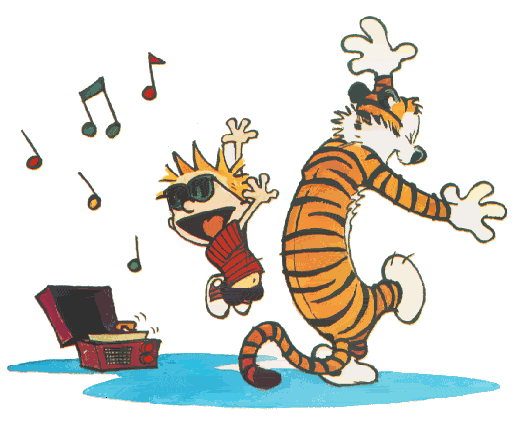
Some New Processes
Support Overview Email – This is sent out everyday by the person on level 1 support at the end of the day – It should document any important information that happened throughout the day.
Information Radiators – New addition to the morning stand up meeting.
Notice to move scrum times – as much notice as possible must be given to support if the scrum time is to be pushed out until 5pm GMT – 9am EST due to customer facing meetings or extenuating circumstances.

Slide 18
Any Questions?
Thank You!

