Slide 1
Using Scotty Pro
Michelle McCausland

Slide 2
Topics
General overview – what is ScottyPro and why do we use it?
Support Workflow
Creating tickets
Adding attachments
Adding comments
Changing state

Slide 3
What is ScottyPro
ScottyPro is an Errigal created software that is based on the ticketer application.
It is used to track work in workflows with tickets.
It is currently used by Errigal for support purposes only.
Logo TBD

Slide 4
ScottyPro “Boards” Workflows
The ScottyPro system uses workflows for each project.
For example the support workflow is “Errigal Support Request”.
This workflow has core states:
Open
In Progress
On Hold
Awaiting Response from Customer
Customer Response Provided
Resolved/ Closed
It is up to the support person to ensure that all of your assigned tickets are in the correct columns on a day to day basis.
Open
In Progress
Closed

Slide 5
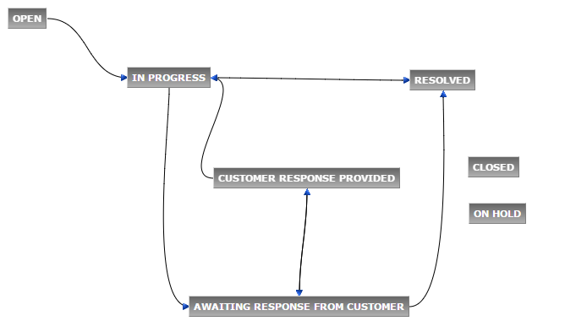

Slide 6
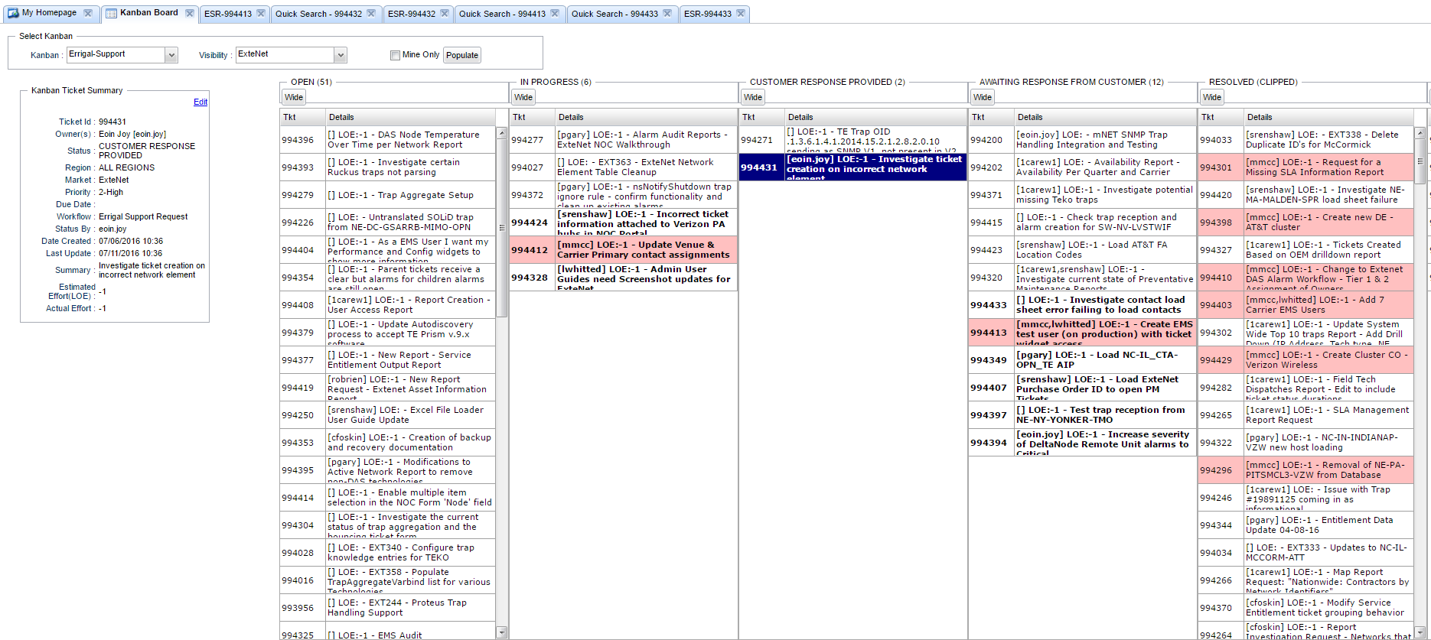

Slide 7
Todo
Newly created tickets start life in this column.
Items are listed in order of priority i.e. items ranked with a priority of 1 – Critical are of most importance and are higher on the Kanban board, whereas items marked with a rank of 5 – Very Low are of very low importance and are lower down on the Kanban board.
The top 10 items are usually of most importance and should be assigned to people on support to work on.
Tickets stay in this column until the support person begins work on it and it moves to in progress.

Slide 8
In Progress
Tickets that are actively being worked on by support team are in this column.
Once a ticket has entered this state it should not move back to To Do.
Tickets in this column should always have an assignment associated with them so the work can be accurately tracked.
This is highly important for the customer to see these assignments so they will then know who to contact regarding a specific ticket.

Slide 9
On Hold
Items in this column cannot have work done on them until some criteria or information is found / implemented.
Usually the customer requests tickets be put into this column.
Once work can resume on this ticket it is then moved out of this state.

Slide 10
Customer Response Provided
When a customer has responded to a ticket they will place it in this column.
The support person assigned to this ticket is responsible for moving it out of this state:
  Either back to In Progress when work continues on the ticket
  Or back into awaiting response from customer following an email to the customer
  Or into closed
The ticket is in this column because the customer believes it is no longer their responsibility.
As such, you must send an email to the customer explaining the work carried out in order to move this ticket back to awaiting response from customer.

Slide 11
Awaiting Response From Customer
Once you have completed the requirements of the support ticket and an email has been sent to the customer the ticket is placed in this column.
If there has been no response from the customer after 7 days of the ticket being moved into this column a follow up email must be sent to the customer asking for an update.

Slide 12

Closed
Once the work is completed on a ticket and we are given the go ahead from the customer we put tickets into this column.
The more tickets we close in any given week the happier our customers will be!

Slide 13
Anatomy Of A Ticket
Each ticket holds a wide array of content pertaining to that ticket.
The general description of the ticket, who is assigned to the ticket and comments associated with the ticket are the main categories of note.
The more information that is captured in a ticket the easier it is to search for tickets and the easier it is for everyone involved to search for details of a particular ticket.

Slide 14
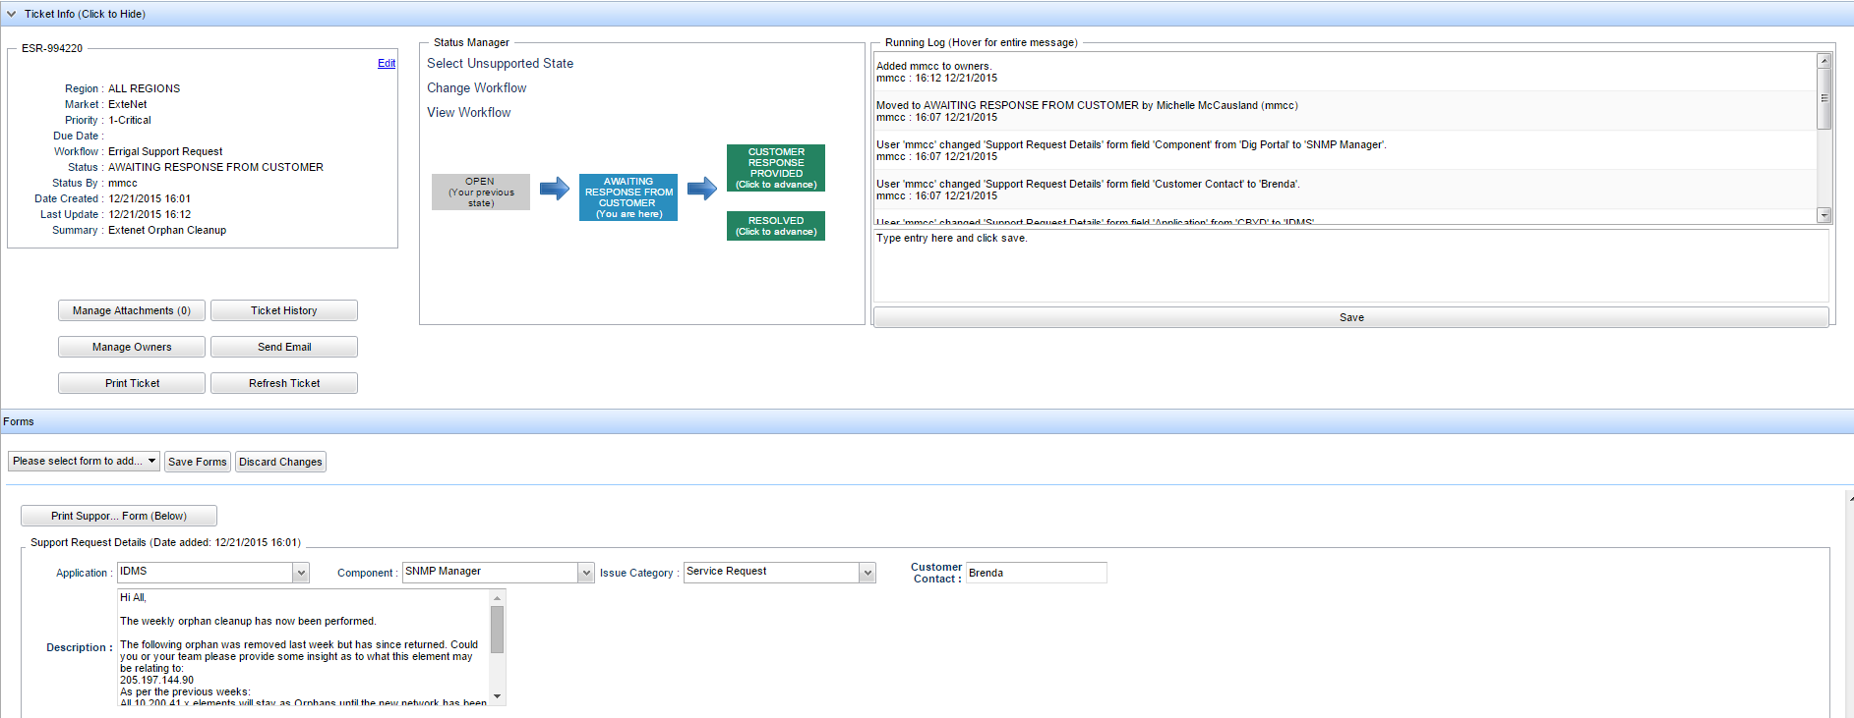
Anatomy Of A Ticket ctd.

Slide 15
Comments
Comments are included during the life of a ticket to keep everyone informed of the work completed on a ticket, steps taken to resolve the issue, problems faced etc.
Comments should be clearly formatted !
As part of the new support process every email correspondence with the customer must be placed in a comment on the ticket – this means that all information associated with this ticket can be found in the ticket which avoids the need to look in multiple locations.

Slide 16
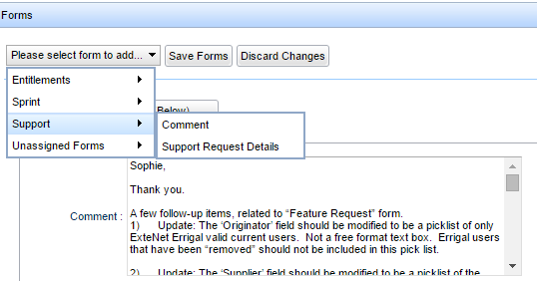
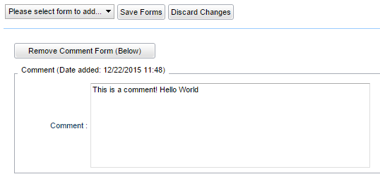
Adding A Comment Via A Form
To add a comment to a ticket via a form click the please select form to add dropdown in the forms section and under the support section choose comment.
With the form added you can add your comment and click the Save Forms button to save your changes.

Slide 17
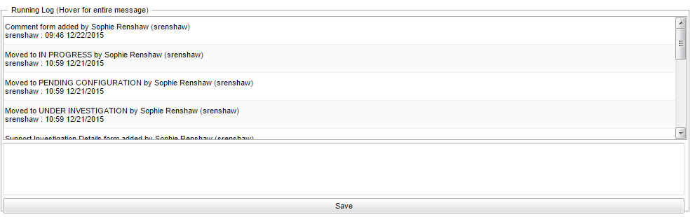
Add A Comment Via Running Log
Certain short comments can be added to the running log such as “Ticket reopened for X reason” or “Closing this ticket as it is no longer needed” etc.
The running log is found on the right hand side of the ticket.
Simply type your comment into the text box and click Save to save the changes.

Slide 18
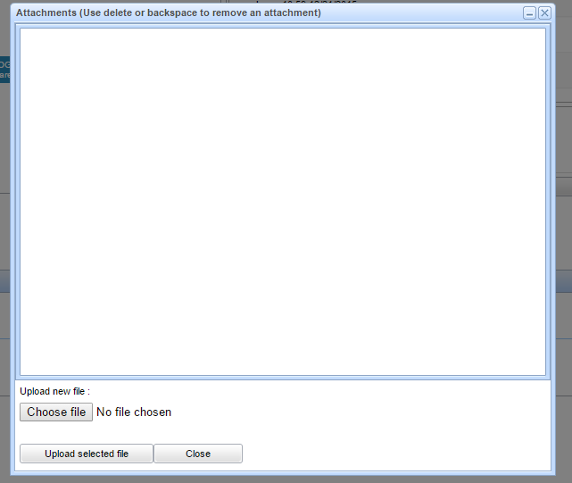
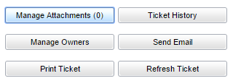
Adding An Attachment
Quite often a ticket will contain a screenshot or some sample data to further describe the task.
In order to add attachments to a ticket click the Manage Attachments button.
Choose the file you wish to attach then click Upload Selected File.

Slide 19
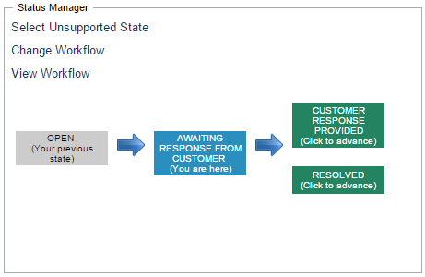
Changing State
You can change state in 2 ways:
  1. To the next supported state
  2. To an unsupported state
In order to change to the next supported state, click on the state in the Status Manger flow diagram.
You will be prompted to confirm this; click OK and the
ticket will advance to that state.

Slide 20
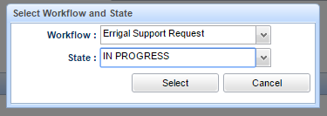
Changing State Ctd
In order to change to an supported state, click on Select Unsupported State in the Status Manger flow diagram.
Select the appropriate state from the state dropdown and click Select.
You will be prompted to confirm this; click OK and the ticket will advance to that state.

Slide 21
Labels
Labels are added to tickets to add extra detail and classification to them.
Communication_Sent – This is added to a ticket when an item is awaiting response from customer but you are awaiting for clarification on an item for example.
Development_Required – This is added to a ticket that requires the creation of a development ticket in order to resolve. The dev ticket must also be linked to this support ticket.
Incident_Investigation – This is added to investigation tickets that are not full outages and do not require a formal RCA but some detailed info. Is required.
Escalated_Priority – This is added when a ticket requires a high level of priority. A support person assigned these tickets must treat it as their no. 1 priority above all else.
Unresolved_Pending_Development – This is added to tickets that are not fully resolved until the development ticket has been resolved. The addition of this label allows the closure of the associated support ticket.

Slide 22
Any Questions?
Thank You!

