Slide 1
Using Jira
Michelle McCausland

Slide 2
Topics
General overview – what is Jira and why do we use it?
Jira board and its components
Support Workflow
Filters
Dashboards
Notes:
Important to mention – this presentation links in with a scotty pro presentation also
General Overview – What is Jira and why do we use it
Jira Board and its components – Projects, Tickets and their components, Assignments, Comments
Support workflow – Using jira for support – life of a jira ticket
Dashboards – Customizing dashboards for ease of use and productivity
Filters – Working with search filters to search for tickets

Slide 3

What is Jira
At its core Jira is a project management tool.
Provides an easy to use interface that is suitable for agile teams.
It is used to track work on boards with tickets.
Used by Errigal for both Support and Development.

Slide 4
Jira Columns “Swimlanes”
A Jira board is made up of sections.
This shows you what status a ticket is in.
The main support boards are made up of 6 columns:
  1. To do
  2. On Hold
  3. In Progress
  4. Response Received From Customer
  5. Awaiting Response From Customer
  6. Closed
It is up to each support person to ensure all assigned tickets are in the correct columns on a day to day basis.
To do
Ticket Created & Assigned
In progress
Work on ticket
Closed
Work Done

Slide 5
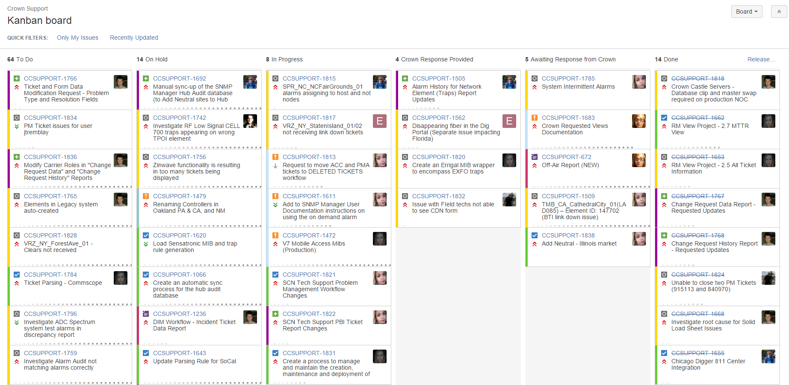
Notes:
Swim lanes
Priorities
Assignments
Filters

Slide 6
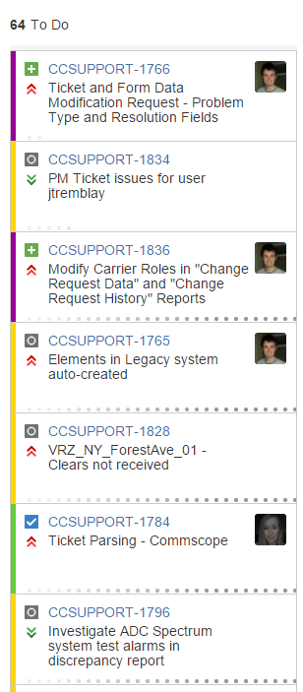
To do
Newly created tickets start life in this column.
Items are listed in order of priority i.e. items at the top are high priority, items at the bottom are low priority or have yet to be prioritized.
Items are almost always prioritized by the customer.
The top 10 items are of most importance and should be assigned to people on support to work on.
Tickets stay in this column until the support person begins work on it and it moves to in progress.

Slide 7
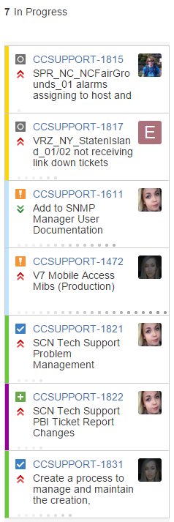
In Progress
Tickets that are actively being worked on by support team are in this column.
Once a ticket has entered this state it should not move back to To Do.
Tickets in this column should always have an assignment associated with them so the work can be accurately tracked.
This is highly important for the customer to see these assignments so they will then know who to contact regarding a specific ticket.

Slide 8
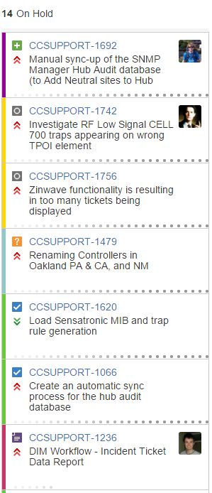
On Hold
Items in this column cannot have work done on them until some criteria or information is found / implemented.
Usually the customer requests tickets be put into this column.
Once work can resume on this ticket it is then moved out of this state.
Notes:
Example: If customer says – “we can’t work on this ticket until this other ticket has been completed”

Slide 9
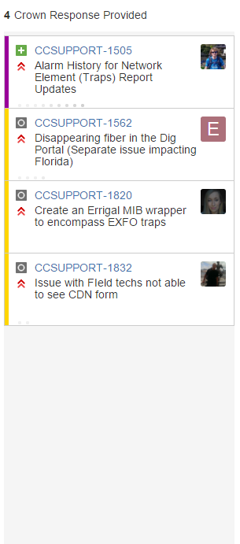
Response Received From Customer
When a customer has responded to a ticket they will place it in this column.
The support person assigned to this ticket is responsible for moving it out of this state:
  Either back to In Progress when work continues on the ticket
  Or back into awaiting response from customer following an email to the customer
  Or into closed
The ticket is in this column because the customer believes it is no longer their responsibility.
As such, you must send an email to the customer explaining the work carried out in order to move this ticket back to awaiting response from customer.
Notes:
For Example: working on a report, work completed & sent to customer, customer replies asking for a new field, renaming a field etc.

Slide 10
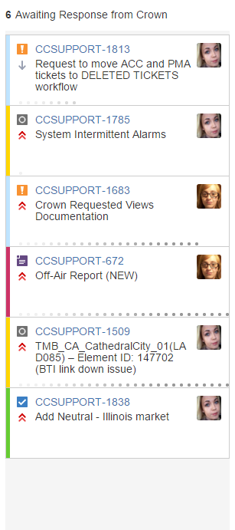
Awaiting Response From Customer
Once you have completed the requirements of the support ticket and an email has been sent to the customer the ticket is placed in this column.
The email correspondence is added to the ticket in a comment.
If there has been no response from the customer after 7 days of the ticket being moved into this column a follow up email must be sent to the customer asking for an update.
If no response has been received for a further 7 days this should be escalated to the support co-ordinator who will then take the appropriate action.

Slide 11
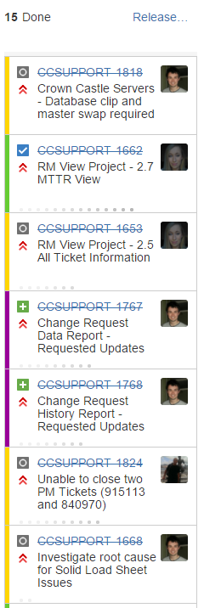

Closed
Once the work is completed on a ticket and we are given the go ahead from the customer, the ticket is moved into this column.
The more tickets we close in any given week the happier our customers will be!

Slide 12
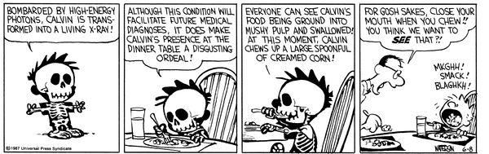
Anatomy Of A Ticket
Each ticket hold a wide array of content pertaining to that ticket.
The general description of the ticket, who is assigned to the ticket and comments associated with the ticket are the main categories of note.
The more information that is captured in a ticket the easier it is to search for tickets and the easier it is for everyone involved to search for details of a particular ticket.

Slide 13
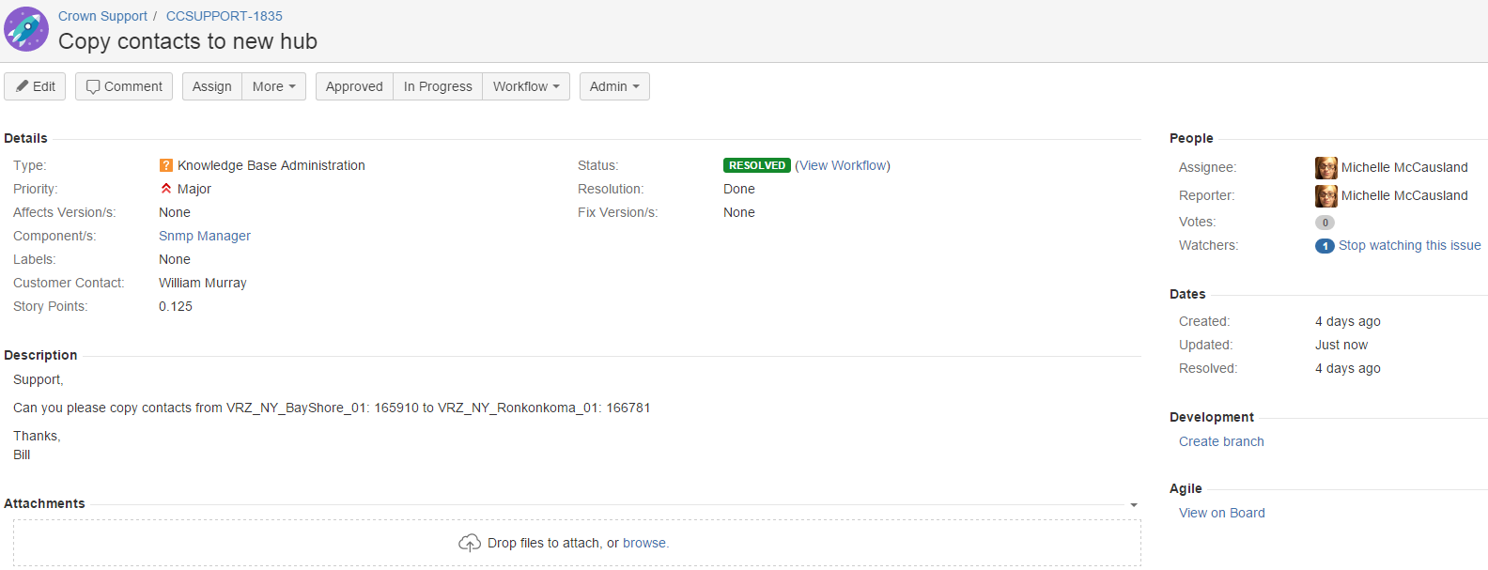
Anatomy Of A Ticket ctd.

Slide 14
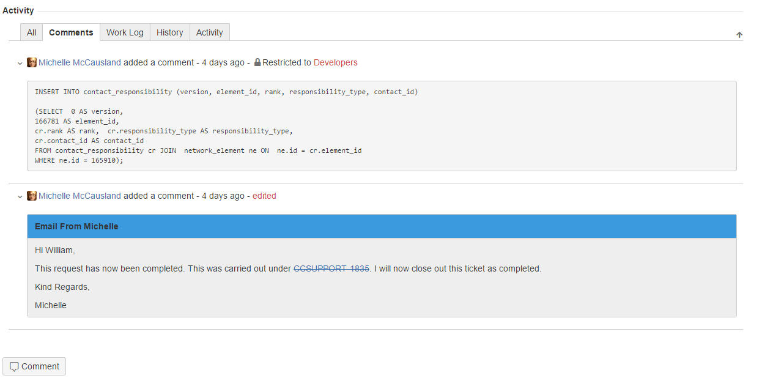
Anatomy Of A Ticket ctd.

Slide 15
Comments
Comments are included during the life of a ticket to keep everyone informed of the work completed on a ticket, steps taken to resolve the issue, problems faced etc.
Comments should be clearly formatted and easy to read.
As part of the new support process every email correspondence with the customer must be placed in a comment on the ticket – this means that all information associated with this ticket can be found in the ticket which avoids the need to look in multiple locations.
To control who can see the comment you are about to publish click the lock icon above the Add button and select the role you wish.
  Developers – this visibility is just for those within Errigal – use this when discussing items internally or when inserting code.
  All Users – this is the default visibility and allows all Jira users to see this comment.

Slide 16
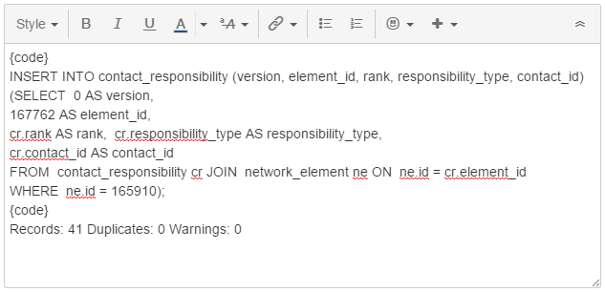
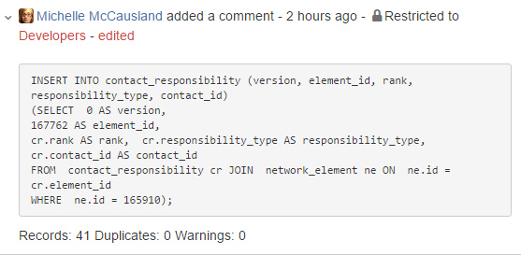
Comments Ctd.
Code
Published Result

Slide 17
Comments Ctd.
Tagging a user in a comment sends them a notification that you have mentioned them.
In order to tag some one in a comment type @ followed by the user’s name (a drop down will be presented).
Once the comment is saved the tagging will be included on it.

Slide 18
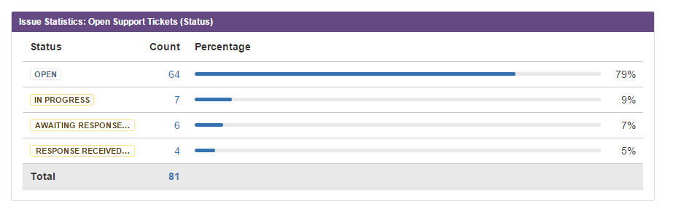
Dashboards
The dashboard is the first page you see when you sign into Jira.
It can be used to great affect to organize your work.
The dashboard can be customized as you wish to include widgets to display ticket information in almost any way you require.

Slide 19
Filters
Filters are a very efficient way to search for tickets based on certain criteria.
I would encourage everybody to experiment with some useful filters depending on what is important to you.
Filters can come in handy when working on similar tickets that may have been worked on before.
Some examples of filters:
  Tickets assigned to me
  Tickets created in the last week
  Tickets that contain the words “Dim Workflow”
Notes:
Example filters on Jira board: tickets assigned to me

Slide 20
Labels
Labels are added to tickets to add extra detail and classification to them.
Communication_Sent – This is added to a ticket when an item is awaiting response from customer but you are awaiting for clarification on an item for example.
Development_Required – This is added to a ticket that requires the creation of a development ticket in order to resolve. The dev ticket must also be linked to this support ticket.
Incident_Investigation – This is added to investigation tickets that are not full outages and do not require a formal RCA but some detailed info. Is required.
Escalated_Priority – This is added when a ticket requires a high level of priority. A support person assigned these tickets must treat it as their no. 1 priority above all else.
Unresolved_Pending_Development – This is added to tickets that are not fully resolved until the development ticket has been resolved. The addition of this label allows the closure of the associated support ticket.

Slide 21
Any Questions?
Thank You!

