Slide 1
Working With Emails
Michelle McCausland

Slide 2
Topics
General Overview
Creating Labels
Creating Filters
Email Best Practices
Searching for Specific Emails

Slide 3
Email Overview
Anyone and everyone in Errigal deals with emails on a day to day basis.
Whether you are dealing with a support request or a development item or even communicating with those in the office, emails are an important part of your day.
This presentation is a guide on managing emails on a day to day basis.

Slide 4
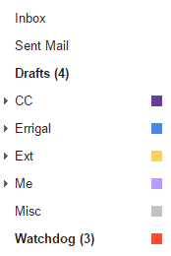
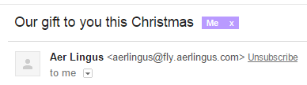

Labels
Labels are a very useful way to categorize your emails.
They work in conjunction with filters to sort your emails into organized groups.
You can create as many or as few as you need.
For example labels can be categorized based on customers which works well for use within Errigal.

Slide 5
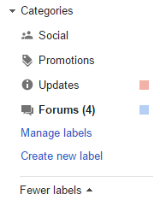
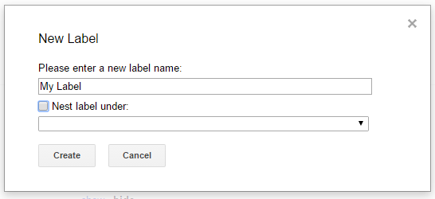

Creating Labels
In order to create a new label click on Manage labels located on the lower left hand side of the gmail screen.
Next, click on Create new label.
You will then be prompted to enter a label name and you also have the option to nest a label under an existing label.
Click Create and you now have your label.

Slide 6
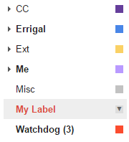
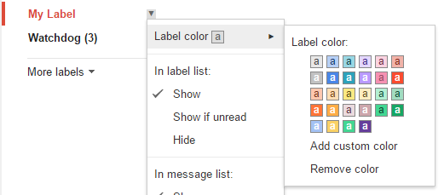
Creating Labels Ctd.
To add a specific colour to associate with your new label find the label along the left-hand side of the gmail screen.
Hover over the right hand side of the label until you see a drop down arrow.
Click on this icon then hover over Label color to choose your colour.

Slide 7
Filters
Filters are an extremely useful way of sorting your emails based on set criteria.
Filters sort emails into labels.
An example of a filter everybody could use is “Emails sent to me specifically”.
This is particularly useful in cases where people are on multiple distributions i.e. support, developers, staff etc.
Further examples include filtering based on customer e.g. emails sent to *@Errigal.com.

Slide 8

Creating Filters
Navigate to settings, then select Filters and Blocked Addresses.
At the very bottom of the page click Create a new filter.

Slide 9
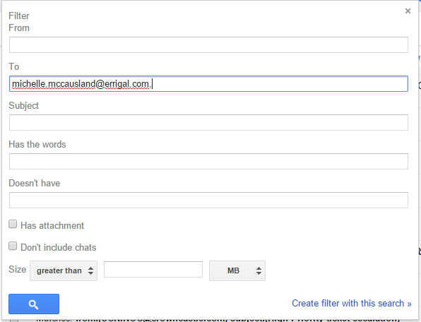
Creating Filters Ctd.
You will then be presented with the filter creation dialog box.
In this instance we will type in our own email address into the “To” field.
Once you are happy with your filter click Create filter with this search. (Bottom Right)
You will then be shown in the background, all of the emails that match your filter.

Slide 10
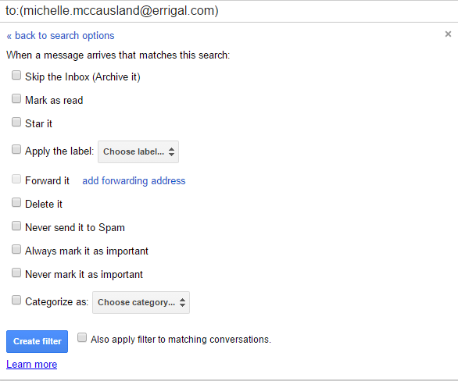
Creating Filters Ctd.
On this screen you are presented with a number of options to further refine your filter.
If you want these emails to skip the inbox check Skip the Inbox.
From here you can apply a label to your filter.
If these emails are all unwanted you can delete them by checking Delete It.
If these emails are highly important it is useful to check Never send it to Spam & Always mark it as important.
It is also useful to check the last box – Also apply filter to matching conversations.

Slide 11
Searching For Emails
In most cases if you are working on a ticket it is useful to check for keywords relating to that ticket in your emails to see if a similar problem has arisen before (check Evernote too); it can save you a lot of time and effort.
If you are searching for emails from a particular source type the following into the search bar: from:michelle.mccausland@Errigal.com / from:emailAddress
Similarly if you are searching for emails directed to a specific person type the following: to:michelle.mccausland@Errigal.com / to:emailAddress
If you know an email has an attachment: has:attachment
If an email belongs to a specific label: label:important / label:labelName
http://www.howtogeek.com/107307/how-to-use-gmails-advanced-search-features-create-filters/

Slide 12
Email Best Practices
It is always important to double check who you are sending emails to before you press send:
  Who is this being sent to - what customer, who else needs to see this email, who does not need to see this email?
  Always CC support@errigal.com when dealing with support requests.
Always include the ticket number and name in the subject line. Failing this try to include a clear description.
Try to be clear and polite when writing emails to customers:
  If you are asking a question ensure that it is understandable and has a clear request or call to action for the recipient.
  If you are providing lots of information use paragraphs and bullets for each point of information, spread the information out and again be clear and ensure the information can be understood by the customer or you will receive an email asking for further clarification.
If you are in anyway unsure about your email before you send it, ask someone to take a quick look at it. A second set of eyes never hurts!

Slide 13
Accessing the Evernote Repo
Additional Information
This presentation, as well as others, are all available in the Evernote Repository.
A copy of some useful Gmail filters is also available in the Evernote Repo in the note “Dealing With Emails”. These can be imported into Gmail.
Everyone working within Errigal has an Errigal email address with the following convention <firstName>.<lastName>@errigal.com
Some useful email distributions:
  staff@errigal.com - Everyone in the company
  developers@errigal.com - Development team
  ireland@errigal.com - Everyone in the Waterford office
  support@errigal.com - Those on 1st Level support
Accessing the Evernote Repository:
Navigate to Evernote.com or download the client.
Username: errigalwiki@gmail.com
Password:
n******1

Slide 14
Any Questions?
Thank You!

