Slide 1

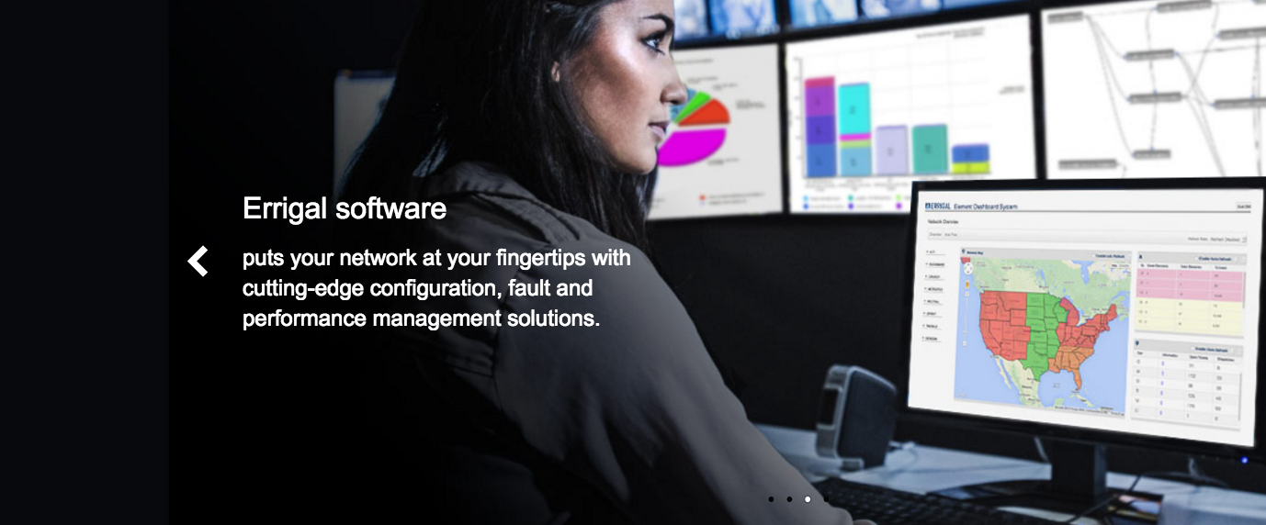
Ticket Creation : Best Practices & Guidelines
Dave McGee

Slide 2
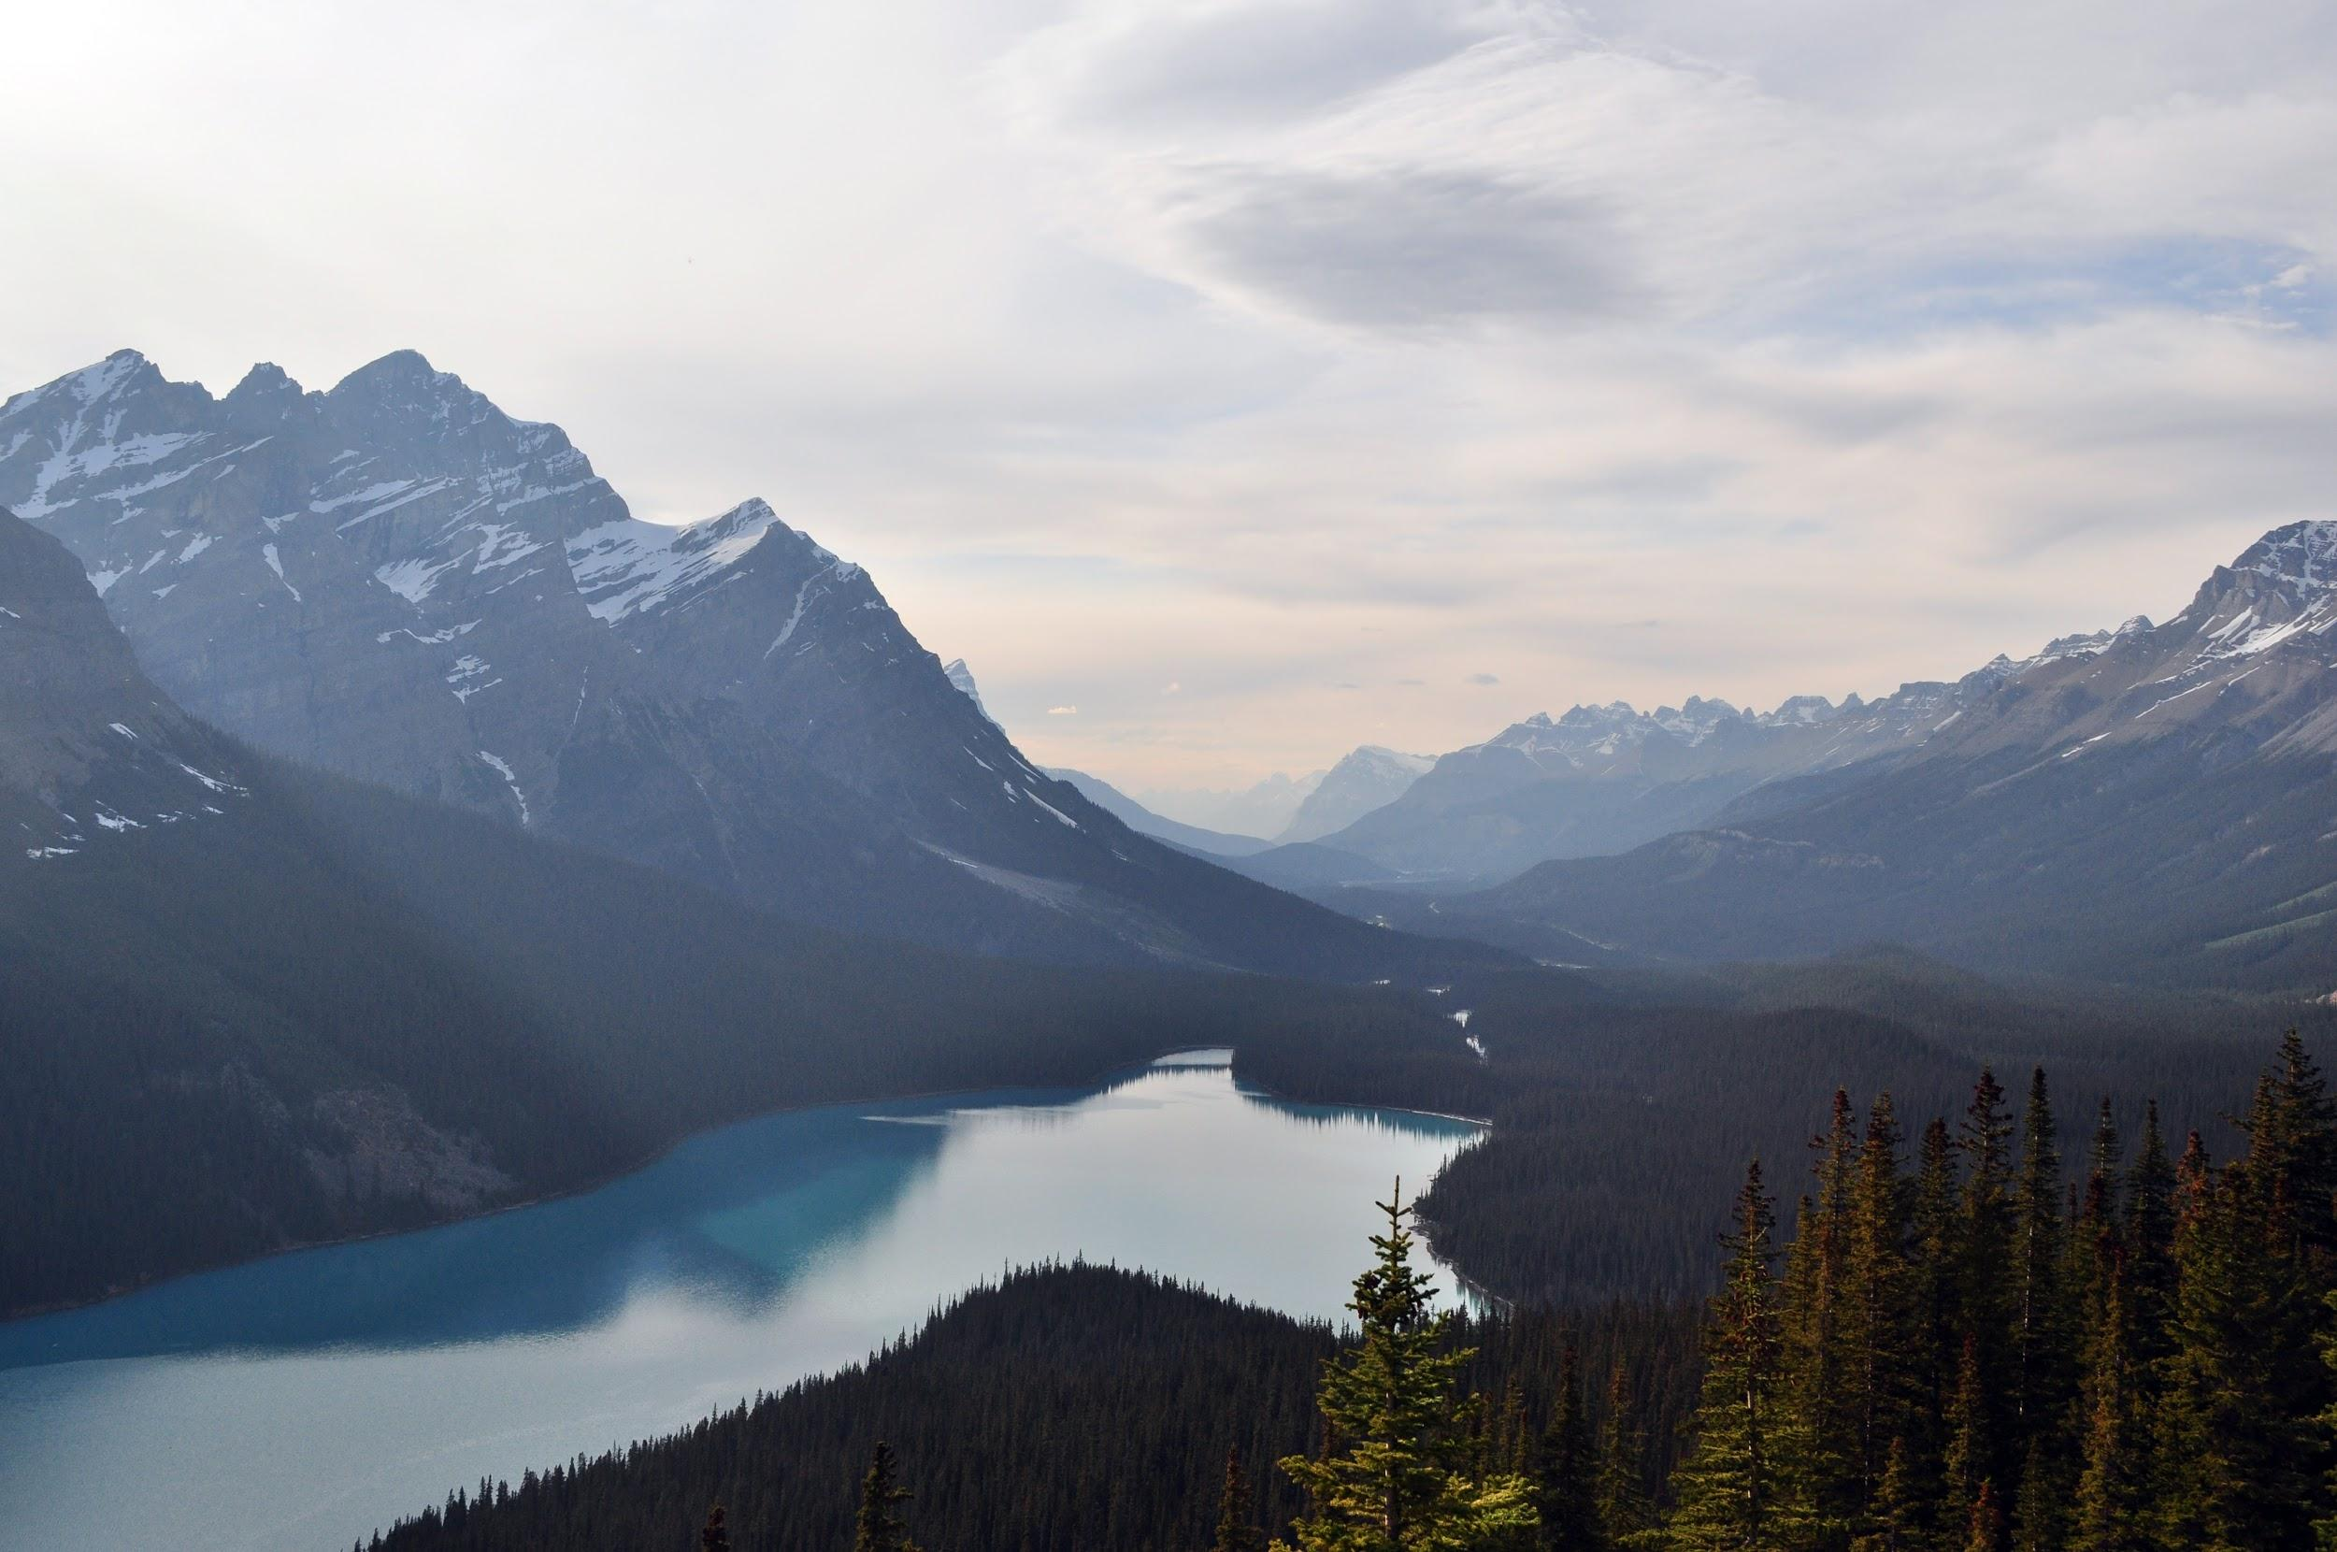
Introduction
This presentation focuses on best practices and guidelines for the creation of tickets within Errigal
  Support
  Development
This particular presentation isn’t intended for training staff on how to use JIRA or ScottyPro
The best practices and guidelines discussed are based off feedback from multiple stakeholders
  Support team
  Development team
  Management
  Billing / Admin / HR
  Customers

Slide 3

Why is this important?
Tickets drive the progress of work from creation through to completion for most of our internal and external, customer-facing work
  Development
  Support
  Operations
From a billing perspective, the Admin department advise us that most of Errigal’s invoicing & billing is processed and calculated against tickets!
Many stakeholders have questions; Everyone deserves answers from tickets! :-)
  Support: “What is the issue, and what troubleshooting steps have already taken place?”
  Development: “What information do I need to replicate this issue?”
  Admin/Billing: “Why was this ticket created and who requested it?”
  Management: “What resources need to be assigned to these issues?”

Slide 4

Context - Some quotes from the team!
We’ve come a long way in the last couple of months! Things have improved and we are all still busy working to improve.
Quote: “This ticket started out as billable and then became not billable - you might let me know if you think the whole ticket should be not billable?” - Unknown source, Admin Team, 2015
Quote: “Tracking of customer communications and time not only impacts billing, but it now has a major impact on the support of our customers and the management of that process.” - Unknown source, Team Leader, 2015
Quote: “The biggest problem is when a ticket is created and there is NO DESCRIPTION (!!!) which just breaks my heart” - Unknown source, Customer support co-ordinator department, 2015.

Slide 5
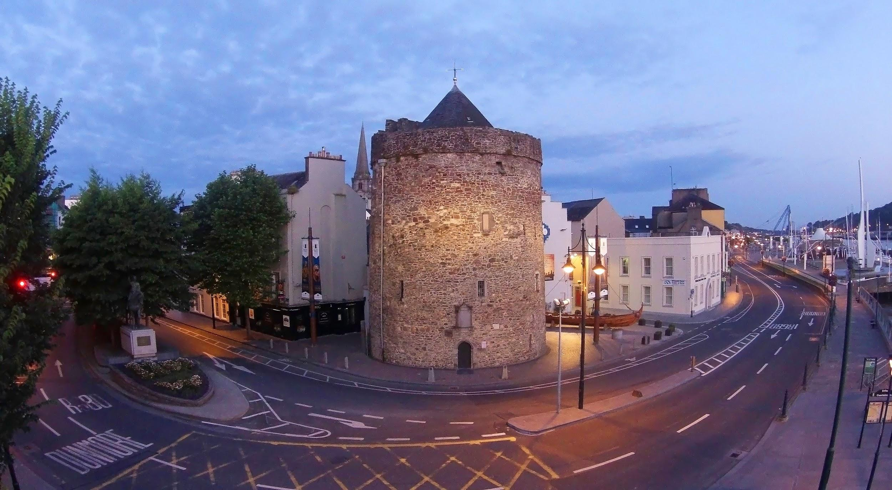
All tickets - General guidelines (Only 8!)
Create tickets with simple, specific explanations that are easy for a non-technical audience to understand
Think about how you summarise, categorise and label your ticket. It could impact billing. Use “Bug fix” with caution!
Make an effort to provide an initial estimate (Story points) on the amount of work you believe the ticket will take. Consult a support person or developer if necessary!
The progress of work on a ticket from creation through to resolution and closure should be documented and reflected in real-time. We want the status of a ticket at any point to be deemed gospel (Example: “In Progress”, “Awaiting Response from customer”).

Slide 6
All tickets - General guidelines (Only 8!)
5. It should be clearly defined what customer requested a ticket, or whether it was requested internally. This helps in efficient communication and deciding if a customer gets billed for it.
6. All customer communications to/from a customer needs to be tracked in the ticket by the ticket assignee, once handed over from 1st level support or within a development sprint.
7. If a support ticket investigation leads to a development ticket being created, the support ticket should be closed with the supporting info, and the dev ticket should reference the support ticket.
8. If a development ticket investigation leads to the creation of a support ticket, the development ticket should be closed with the supporting info, and the support ticket should reference the dev ticket.

Slide 7
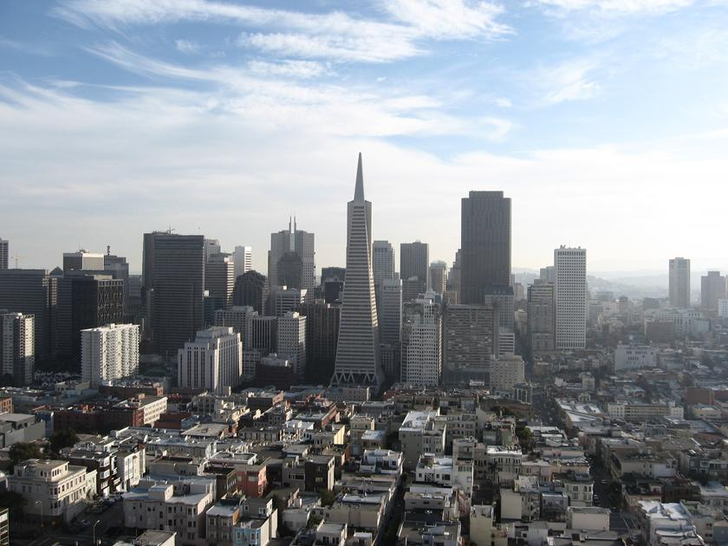
Creating Support Tickets
JIRA Ticket Creation (Crown Castle)
  Fields to focus on that could impact progress, reporting, billing, & management
    Issue Type: Bug, Task, Investigation, etc.
    Summary: Be descriptive but try keep it simple
    Assignee: Leave ‘Unassigned’ until the ticket has been assigned to someone
    Customer Contact: A free-form field to include the customer reporter of the issue
    Original Estimate: Story point estimate measure. Ask for help if needed!
    Description: This could be deemed the most important field.
      This helps us determine who, what, where, when, and possibly why?

Slide 8
Creating Support Tickets
ScottyPro Ticket Creation (ExteNet)
  Fields to focus on that could impact progress reporting, billing, & management
    Summary: Be descriptive but try keep it simple
    Workflow: You should select “Errigal Support Request”
    Market: You should select the relevant customer here (i.e. ExteNet)
    Support Investigation Details Form added on ticket creation
      Application: IDMS, CBYD
      Component: Node Monitor, NOC Portal, etc
      Issue Category: Service Request, Abnormal Behavior, etc.
      SPs: Same as JIRA. Ask for help if needed!
      Customer Contact: Same as JIRA
      Description: Same as JIRA and absolutely vital! (5 Ws!)

Slide 9
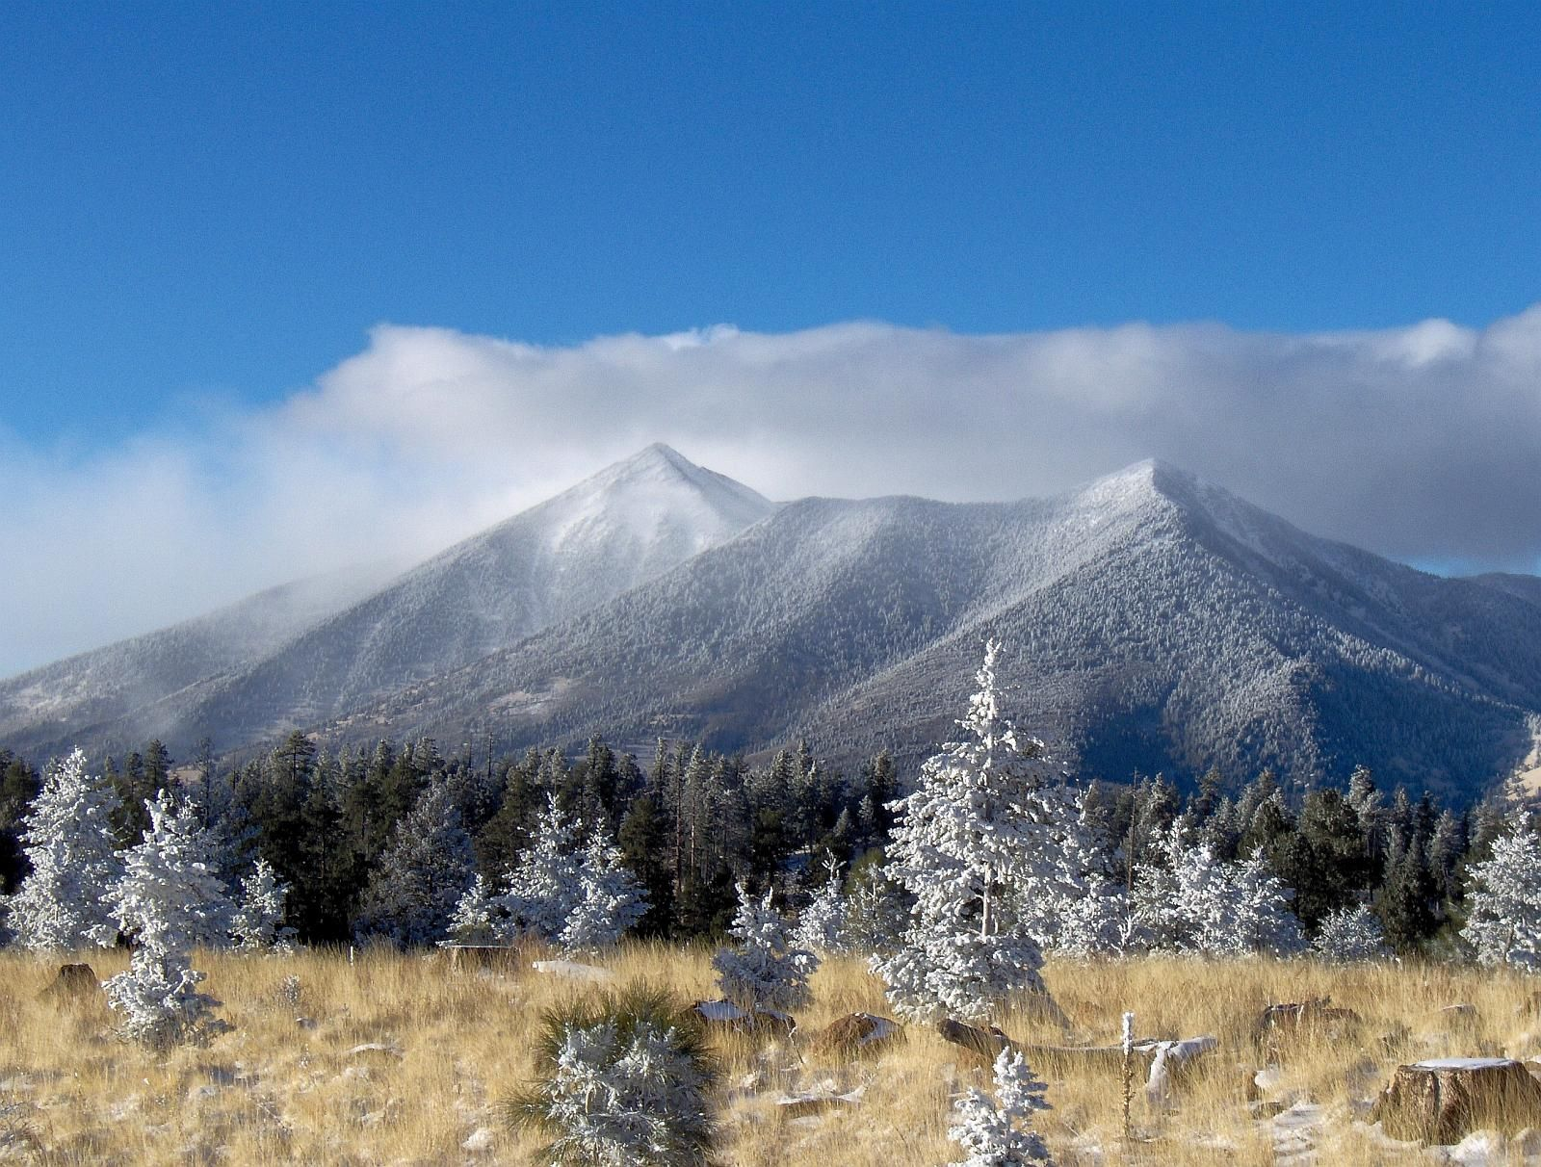
Creating Support Tickets
Bad examples: Focus on summaries and descriptions (No shaming!)
  Summaries that are too general can lead to:
    Breakdown in understanding of a problem between Errigal and customer
    Scope creep
    Tickets living for too long
  Where possible, aim to stray away from tickets with summaries such as:
    “Hub Audit Issues”
    “DIM Workflow Improvements”
    “Support of 3 new technologies”
    “V4 Sensaphone MIBs”
    “Chicago Digger 811 Center Integration” (My bad! - It only took 8 days!)
  Tickets with little or no descriptions can lead to:
    Not understanding a problem
    Troubleshooting the wrong issue (Remember: multiple timezones!)
    No expectations being set for the customer

Slide 10
Creating Support Tickets
Good examples of ticket summaries from the last 30 days (Praise for everyone!)
  “Load new scnoc.crowncastle.com SSL certificate”
    Short and specific
  “Fiber Proximity Incorrect in Dig Portal for ticket A53220982-00A”
    This specifies the field affected, the problem, the application, and the exact end-user ticket impacted.
  “Update PM Email Template to contain an ExteNet Purchase Order ID Field”
    This specifies the customer, email template and the field that needs to be added.
  “Untranslated SOLiD trap from NE-DC-GSARRB-MIMO-OPN”
    Problem = trap not being translated
    Specific network element mentioned
    Specific technology specified

Slide 11
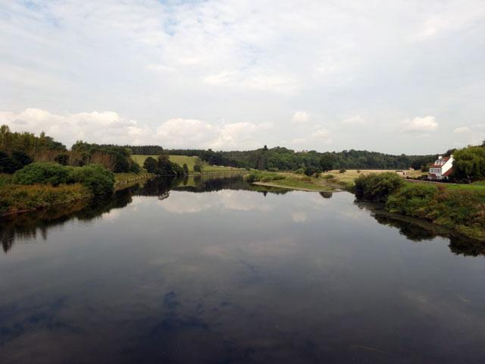
Creating Development Tickets
JIRA Ticket Creation (Crown Castle and ExteNet)
  Fields to focus on that could impact progress, reporting, billing, & management
    Project: IDMS is becoming the master backlog
    Issue Type: Bug, Task, Story (Important for billing!)
    Summary: Use user stories as much as possible (More to come..)
    Story Points: Estimation on level of effort required. Consult with developer/team
    Description: Don’t be afraid to further details here, to compliment a user story
      What is being requested? (Incl. Sequence diagrams, photos of white board sessions..)
      Who is requesting it? (Use cases)
      What problem is it solving?
      Why is this helpful? (Supporting customer communications)
    Security Level: Important to restrict visibility (EXT, CC, ERRIGAL)

Slide 12

User Stories
A very important tool used in agile software development to capture a summary or description of a feature from an end-user perspective, in a ticket!
  Type of user, what they want, and why?
User Stories assist us with
  Agreeing on requirements with customers
  Attempting to fulfil exactly what is being asked for
  Estimating the amount of work required in a development task
User stories should be short, simple and written from the perspective of the person who desires the new capability
As a <type of user>, I want <some function/goal>, so that <some reason>

Slide 13
User Stories
Bad Development Tickets! (No shaming!) : Focus on summaries
  “Workflow save bugs” - WHAT!?
  “Code review use of Object as cache keys” - Where?!
  “We need a hub-level report.” - Who needs it, what does it entail, and where does it go?
  “Alternative to Excel File Loader” - Too vague
  “Clean-up reports view” - Too vague
Good examples of user stories (Remember: As a <type of user>, I want <some function/goal>, so that <some reason>)
  “A dig technician should be able to utilise the "Ruler" tool on Google Maps so they can measure distance on the map between two points”
  “A dig technician should be able to utilise the "View Nearby Nodes" tool for a dig ticket on Google Maps so that they can gather information about what network elements exist in the area of a location”

Slide 14
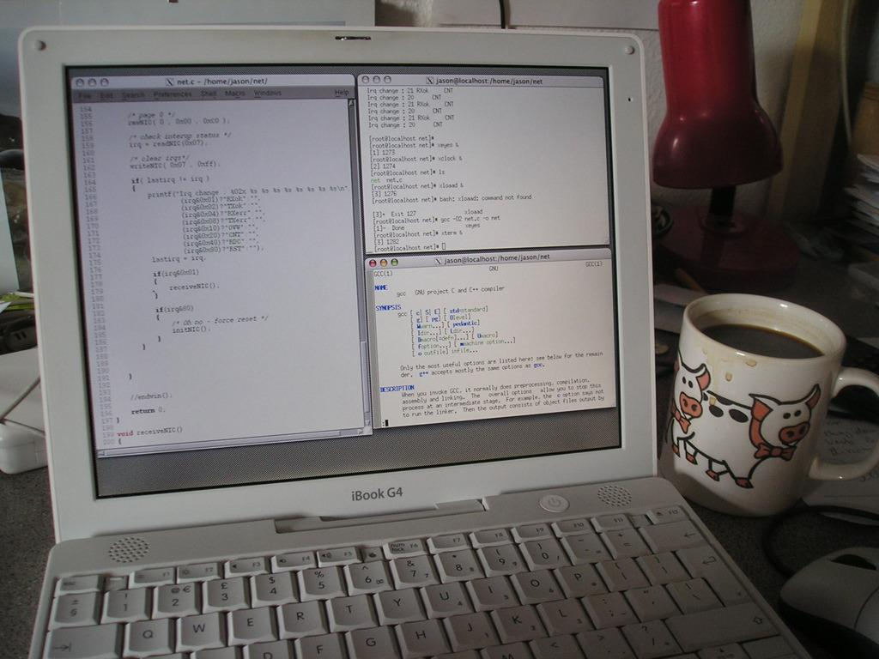
What’s happening right now?
Development tickets are added to backlogs
  Consult with a senior developer before creating a ticket
  Development backlog items are prioritised in development sprints on scrum boards
  Send dev tickets to London for review and customer interface.
Support
  1st level support generally handle creation of most tickets on Kanban boards, but be ready!
  Another Errigal-U presentation is on the way for the overall support process
    Michelle (Friday, Jan 29th at 5pm)
Improvements on the way..
  This is a team effort. We all work with tickets on a day-to-day basis.
  More to come… “ScottyPro Kanban”, “Support-Dev Projects Board” and more!

Slide 15
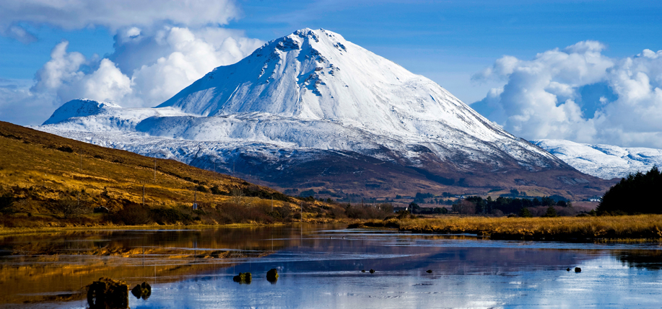
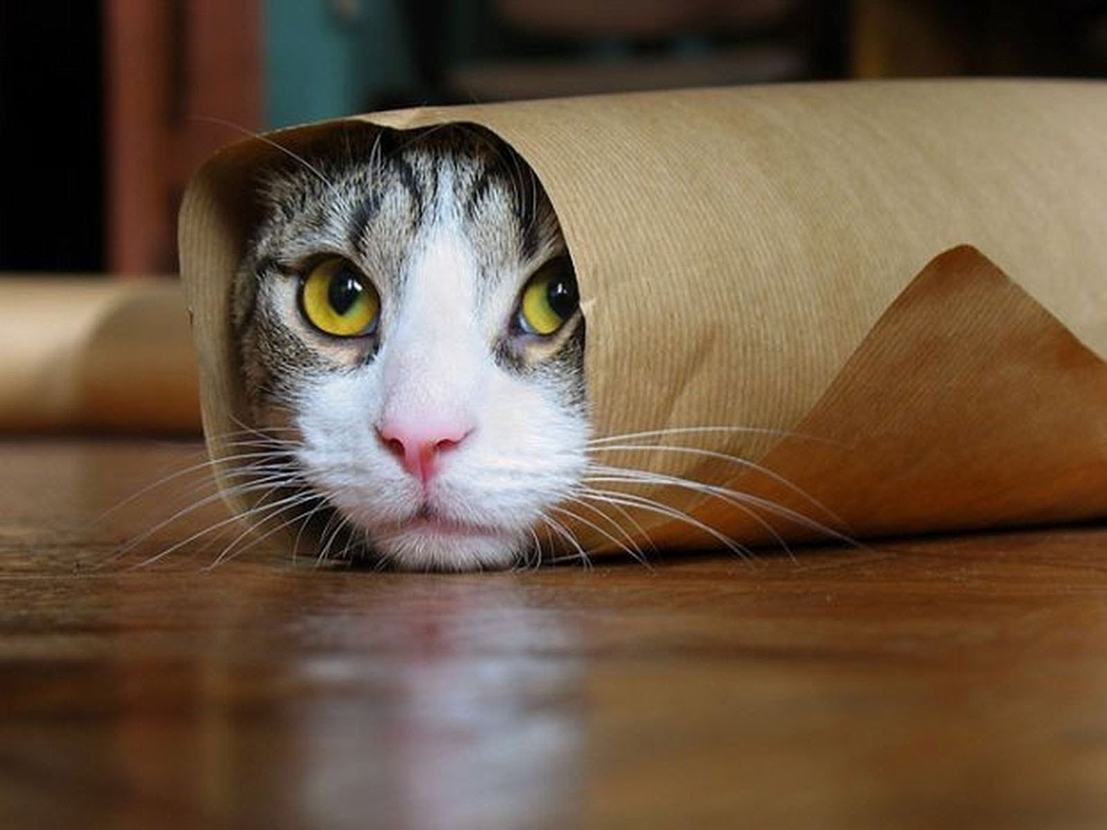
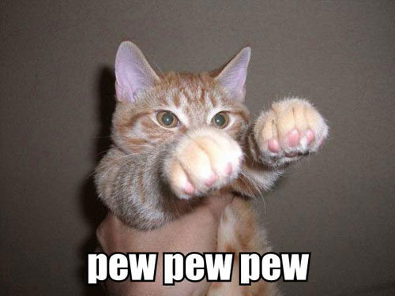
Thanks :)
That was very serious. Here are some cats
Questions/Comments?

